Slide 1
Score Reporting
Scores are required to power the UHSAA RPI
Once the RPI is released, it will update every hour until hidden

Slide 2
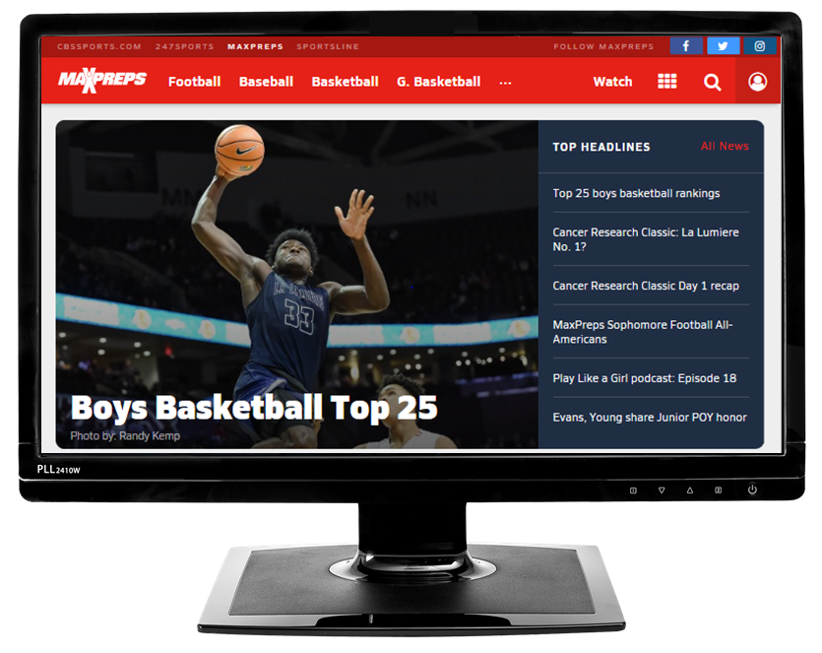
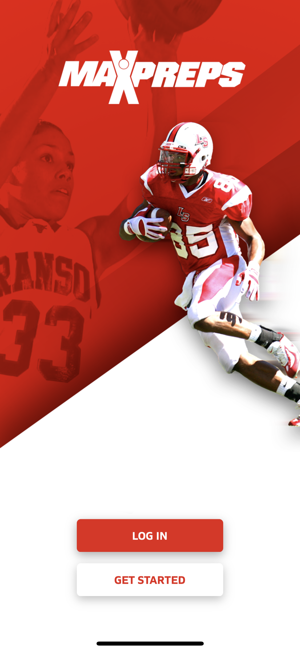
Options for score reporting
Option 1: MaxPreps.com on desktop
Good for schedule setup/entering stats
Option 2: MaxPreps app
Preferred & quickest way to report scores
Ability to enter stats if desired
Native apps: android and iOS
Notes:
Use MaxPreps.com or the MaxPreps app.

Slide 3
Entering schedule and scores on MaxPreps.com

Slide 4
Step 1: Go to MaxPreps.com and click Sign In

Slide 5
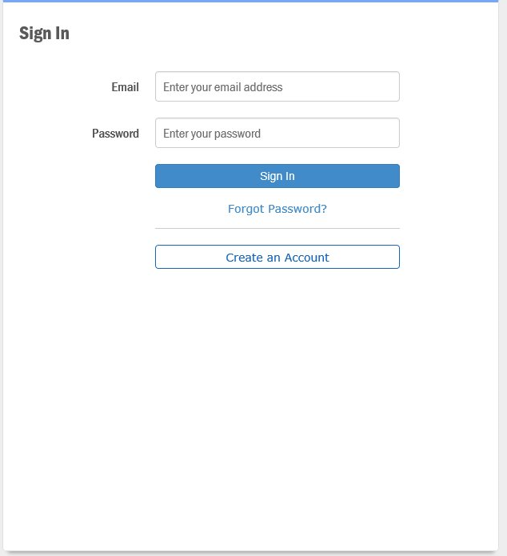
Sign In
Enter your email and password
New users, or those without access should create an account and then email jtaylor@maxpreps.com or their AD

Slide 6
Once signed in, click the user icon in upper right corner
Click on your school
If you’re an AD, it takes you to your AD Admin Area (next slide). Coaches are taken to their Coach Admin Area.

Slide 7
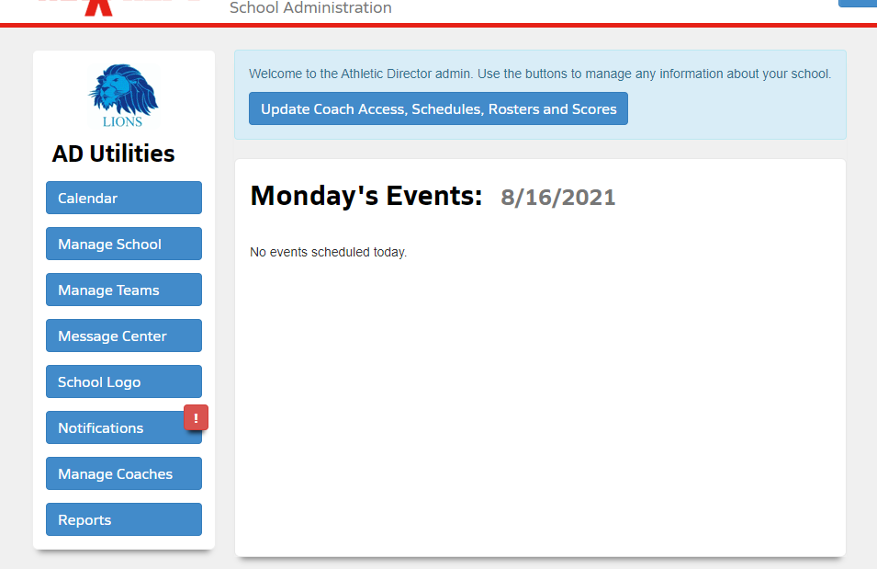
To add coach access, or edit team schedules & scores click on Manage Coaches

Slide 8
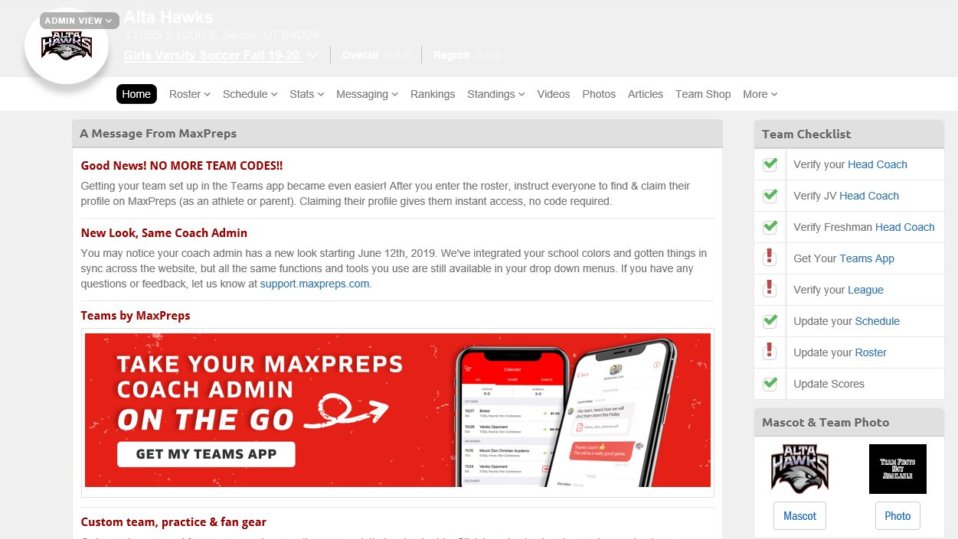
Coach Admin Area

Slide 9
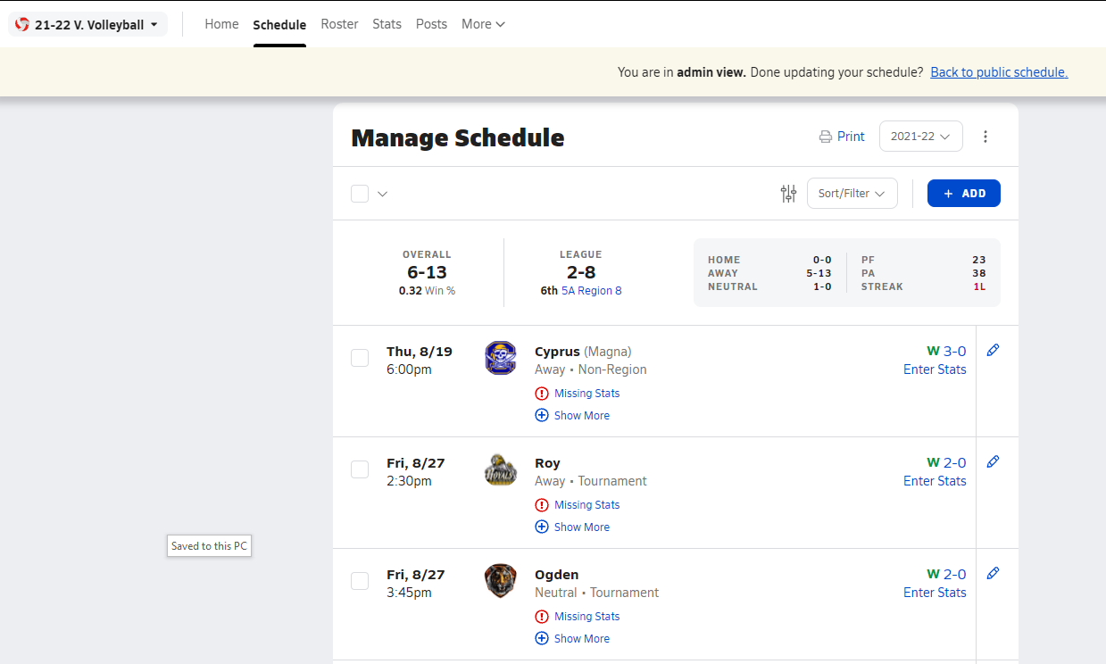

Slide 10
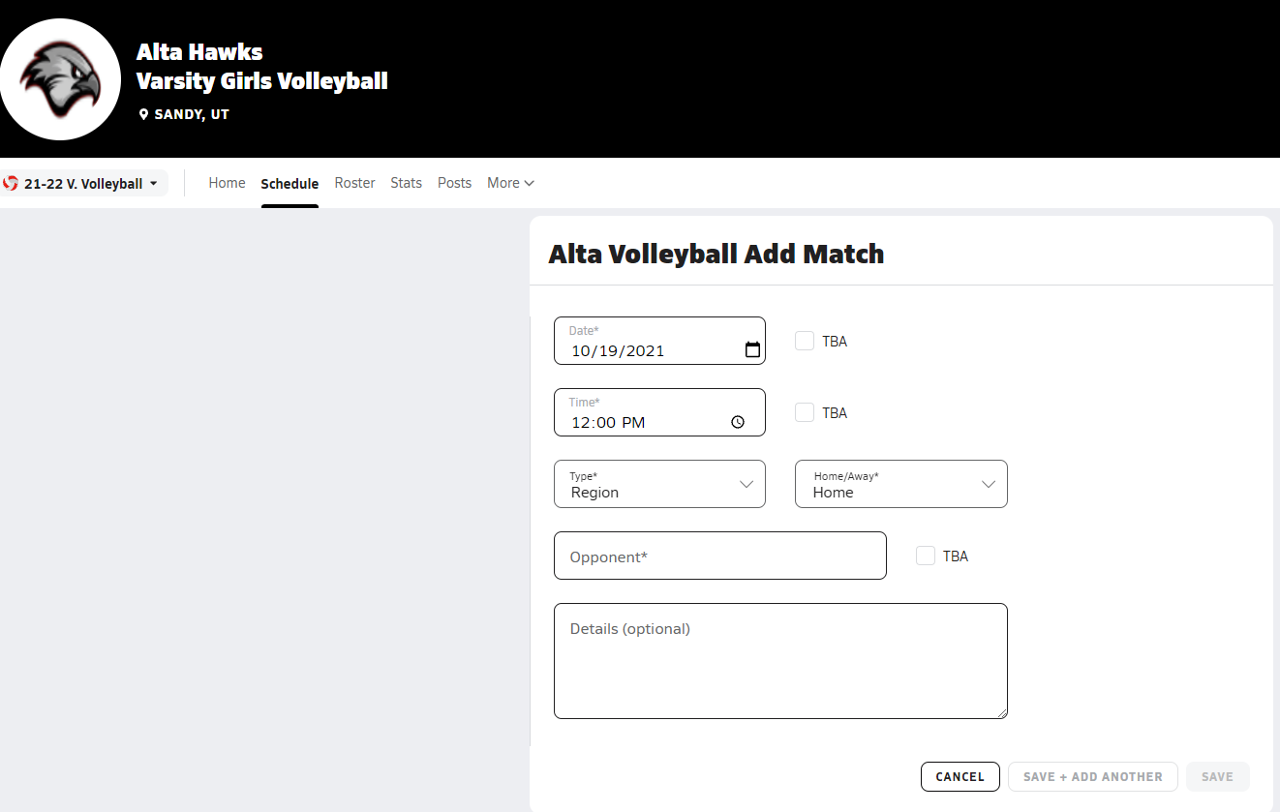

Slide 11
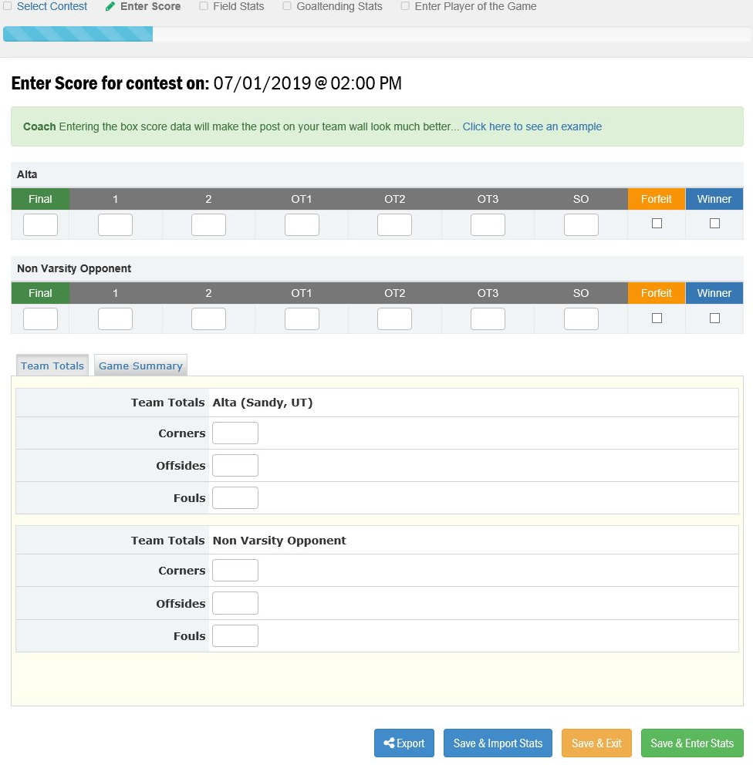
Adding a Score
After pressing the Edit Score button under the Pencil icon from the schedule page you can begin entering a score
For baseball/softball/football this screen will have the added option to directly import GameChanger or Hudl results
Enter the score and click ‘Save & Exit’ or ‘Save & Enter Stats’

Slide 12
RPI Process

Slide 13
Release Process
First rankings released one month after season start date
As scores come in, RPI updates every hour
RPI is hidden 2 weeks prior to state tournament

Slide 14
